Slide 1
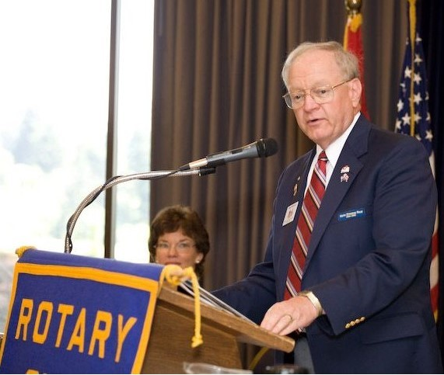
Brian Beagle – 44 Years in Silverdale Rotary – 2 of 3
Joined 1980
President 1985-86
D5020 Conference Co-Chair 2003
D5020 Area 9 Asst Governor 2003-2005
District Governor 2008-09
D5020 Foundation Chair 2009-2013
D5020 Rep - 2016 RI Council on Legislation

Slide 2
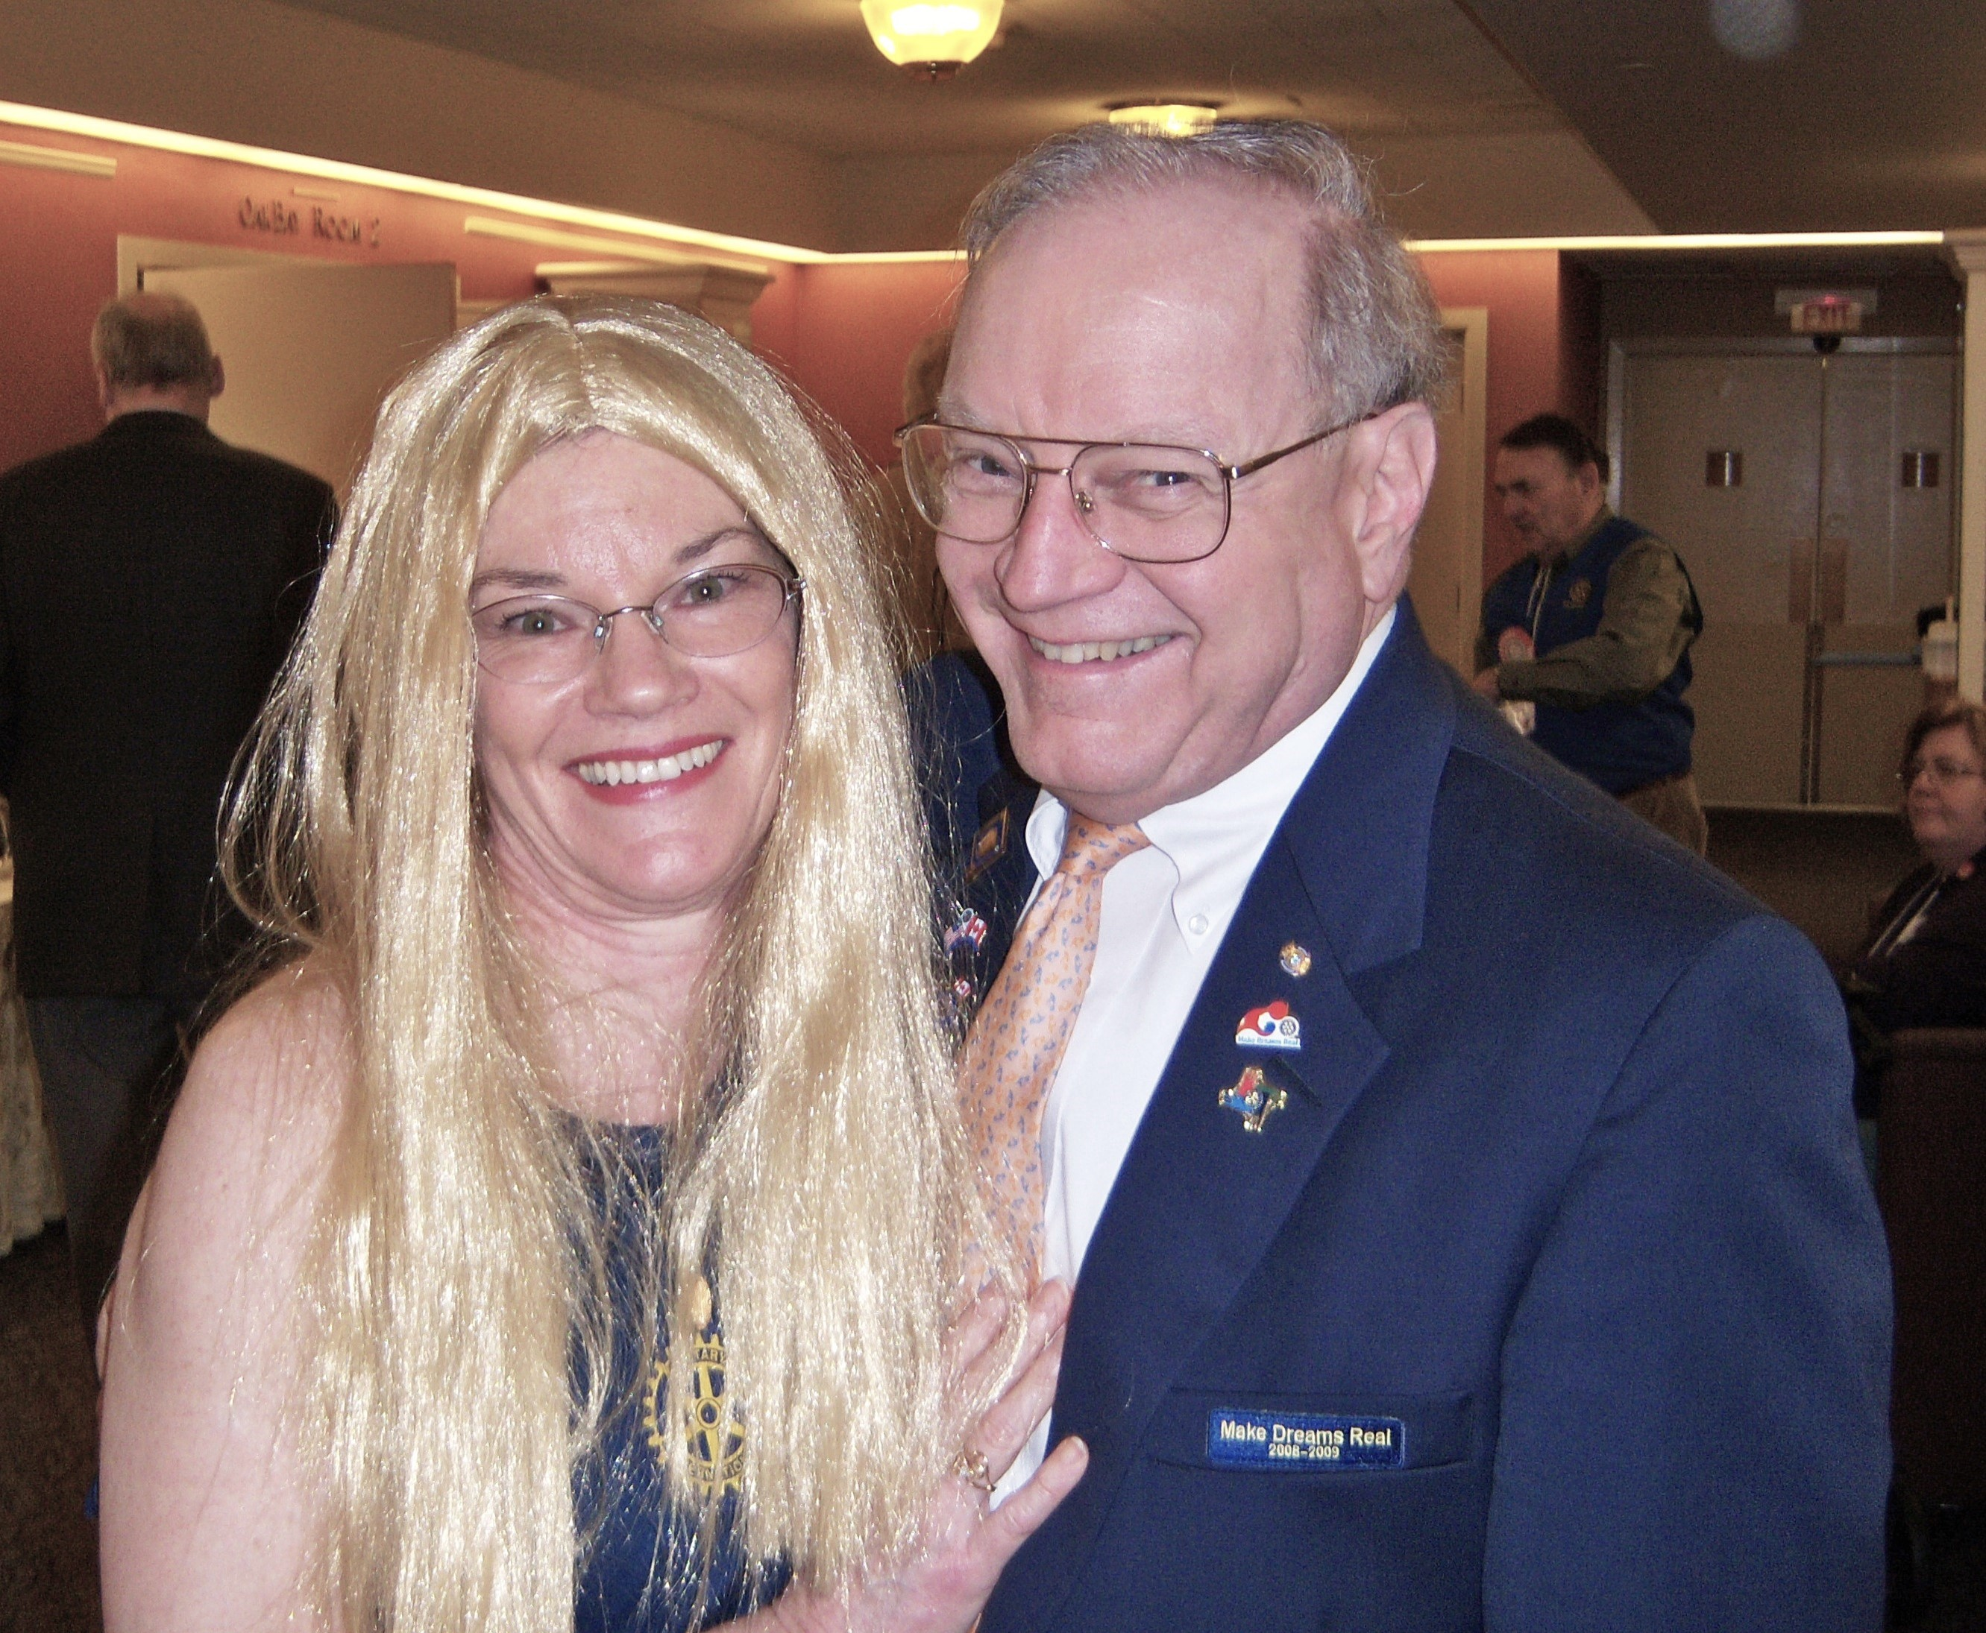
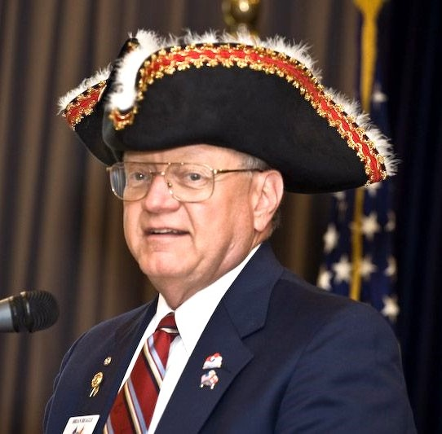
District 5020 Governor 2008-09
Visited 87 Clubs
DG Brian
Pssst – who is that blond with the District Governor?!?

Slide 3
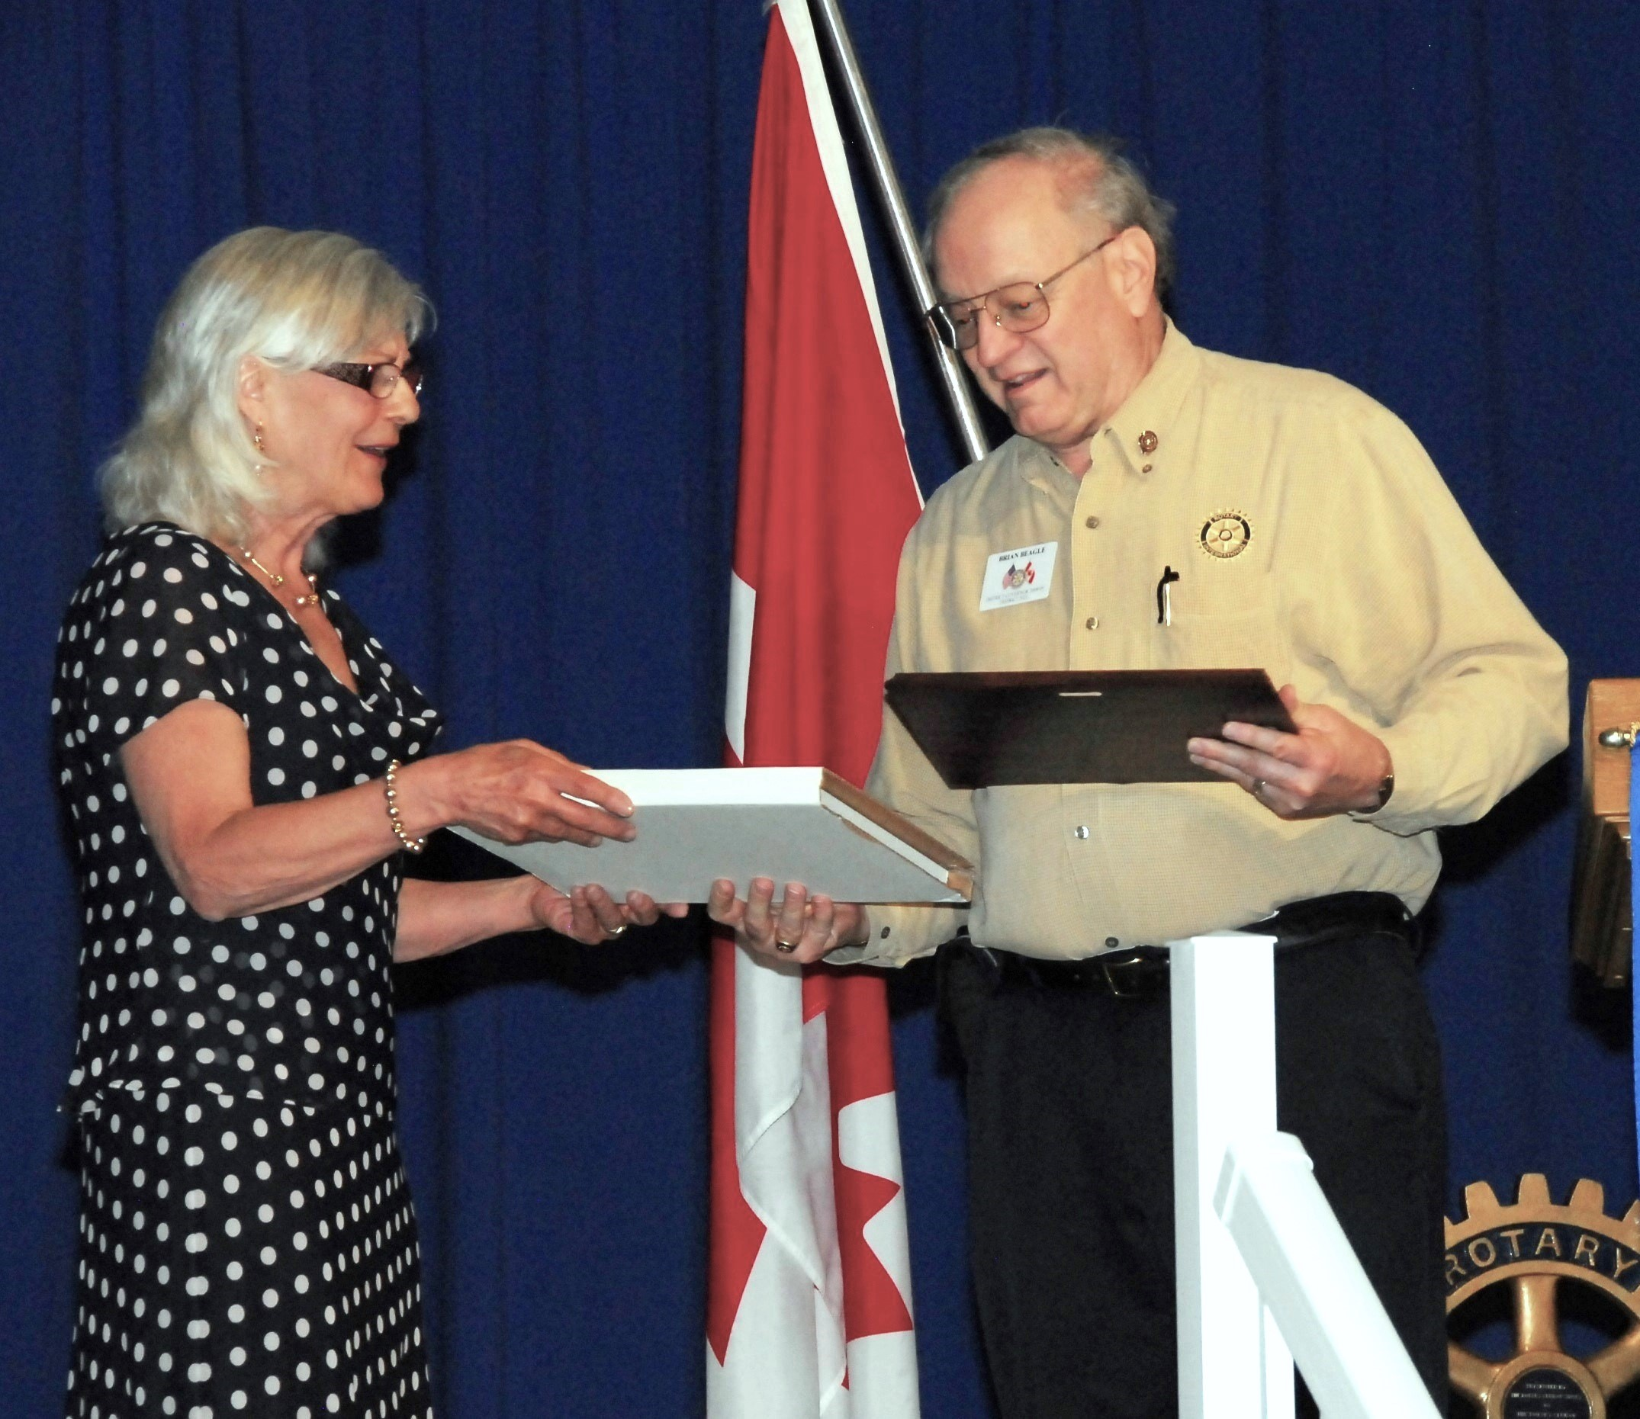
District 5020 Foundation Chair (TRF)
2009-2013
D5020 Hand picked to be Pilot District for new Global and District Grant programs
2013 – Citation for Meritorious Service from the TRF Trustees

Slide 4
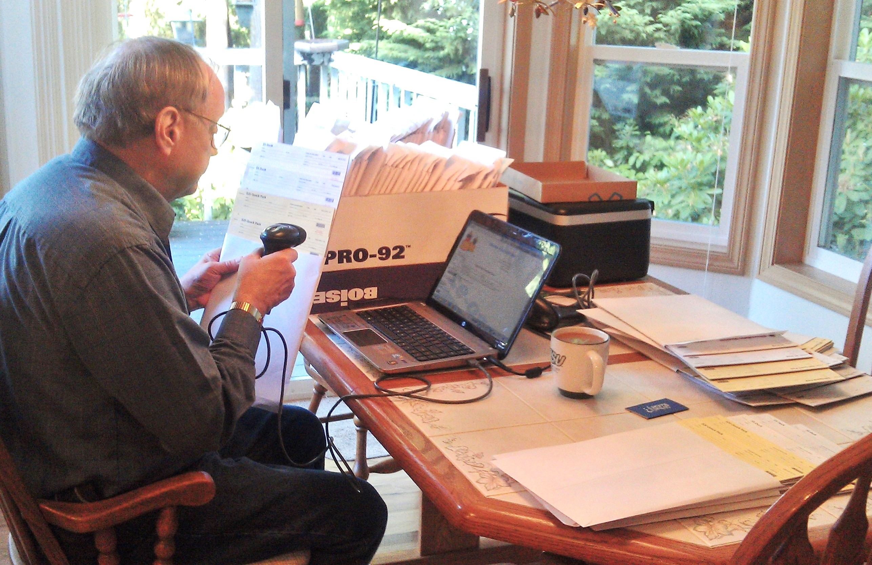
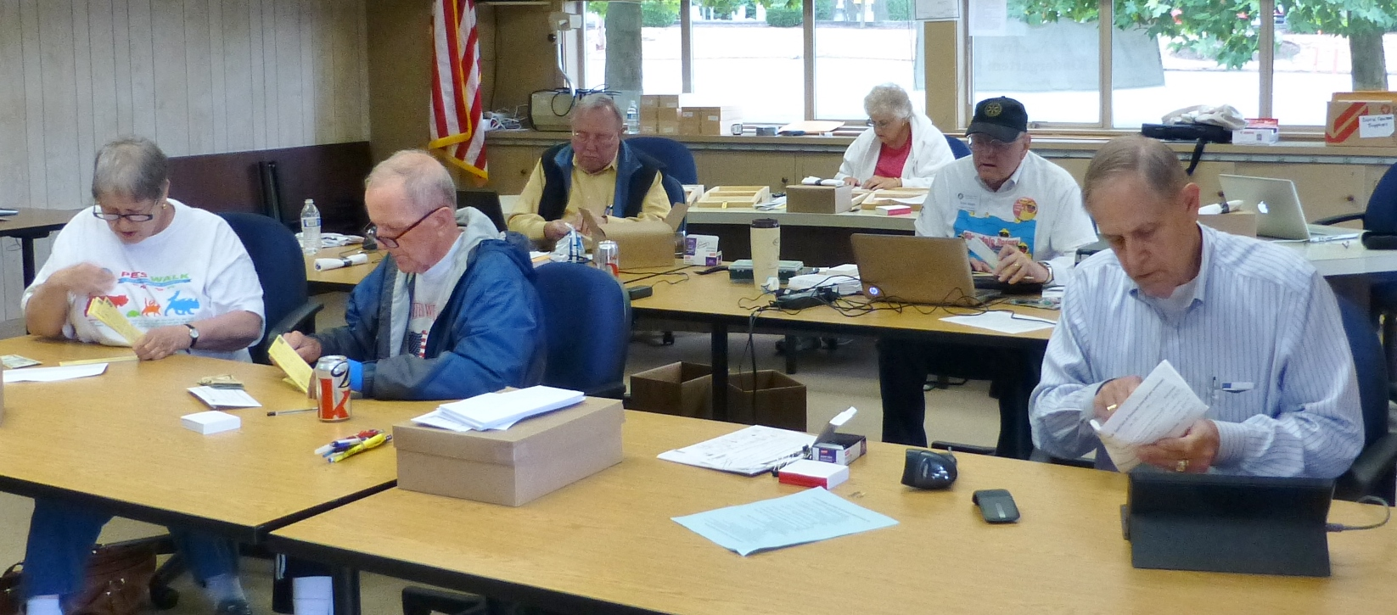
Duck Central
Race Weekend
At our home

Slide 5
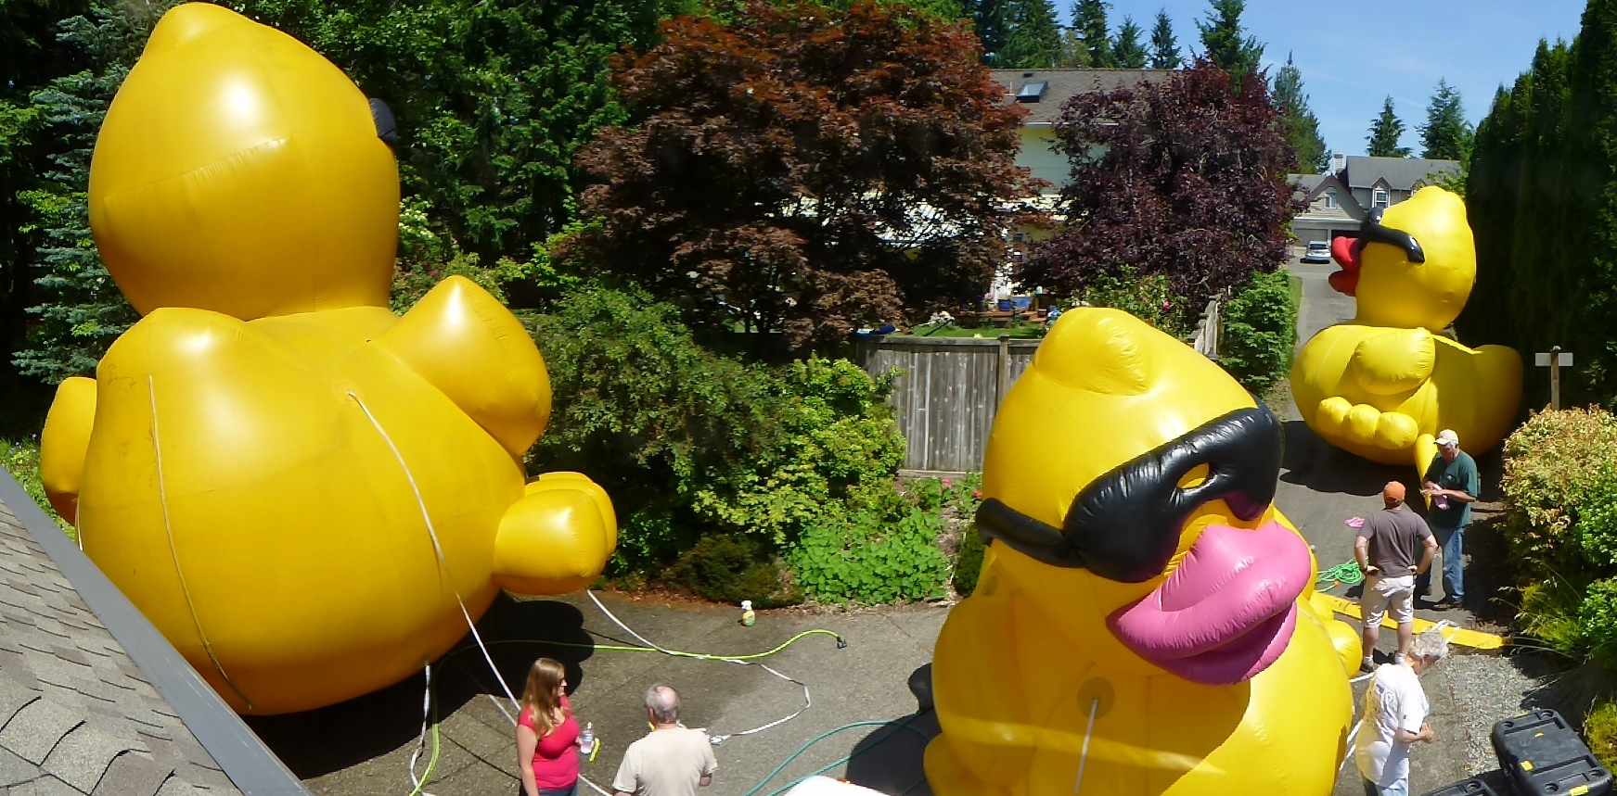
Big Duck Washing at Our Home

Slide 6
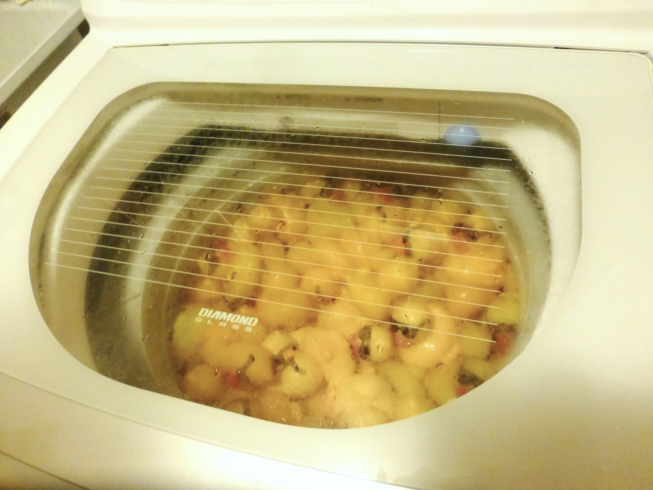
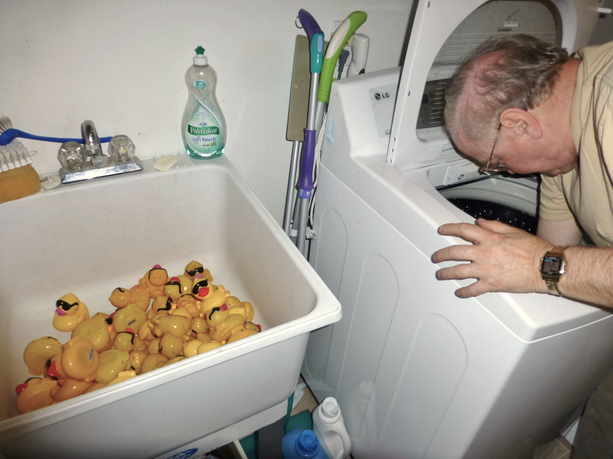
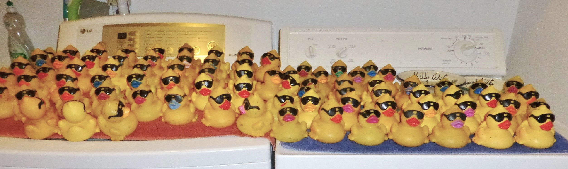
Little Duck Washing at Our Home

Slide 7
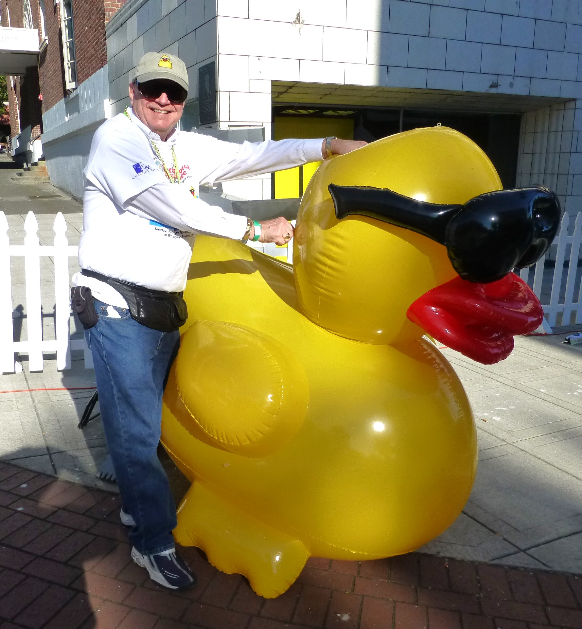
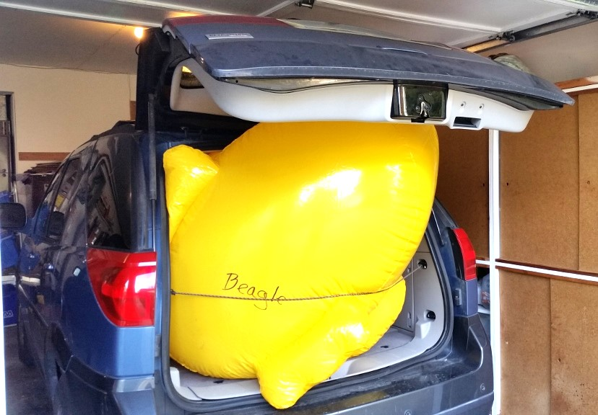
Duck Wrangling

Slide 8
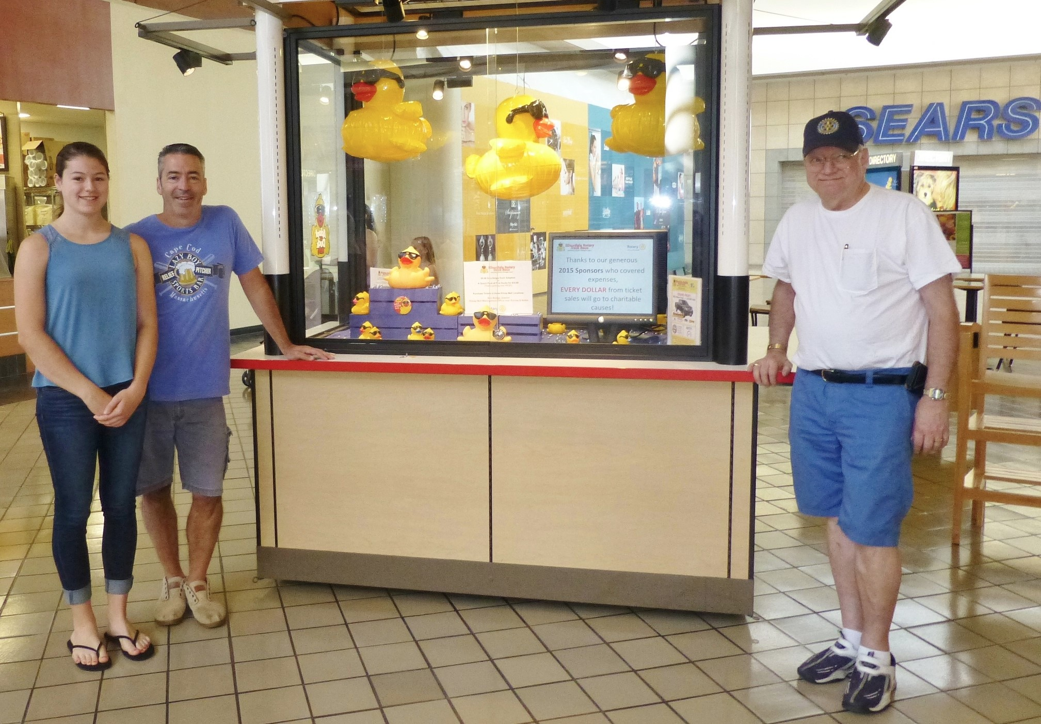
Kitsap Mall Duck Race Cart

